Slide 1

Sentiment analysis of twitter data
Created by :
Rakesh Kedar
Vedant Thapa
Pancham Desai
Siddhesh Gupta

Slide 2

Problem Statement:
Twitter has now become a useful way to build one's business as it helps in giving the brand a voice and a personality. The platform is also a quick, easy and inexpensive way to gain valuable insight from the desired audience. Identifying the sentiments about the product/brand can help the business take better actions.
You have with you evaluated tweets about multiple brands. The evaluators(random audience) were asked if the tweet expressed positive, negative, or no emotion towards a product/brand and labelled accordingly.

Slide 3


Outline story
A festival called SXSW ‘South by Southwest’ takes place in USA, Texas, Austin City. It is happens generally in month of march . This festival is taking place for last 32 years in Austin city.
The twitter data provided to us is during the period of this festival.
Many events takes place during this festival. And the Analysis which is done is based on the reaction of people on various events occured during this festival
Official Logo of the festival

Slide 4
Dataset Description :
This dataset contains around 7k tweet text with the sentiment label.
The file train.csv has 3 columns
Tweet ID - Unique id for tweets.
Tweet - Tweet about the brand/product
Sentiment - 0: Negative, 1: Neutral, 2: Positive, 3: Can't Tell

Slide 5
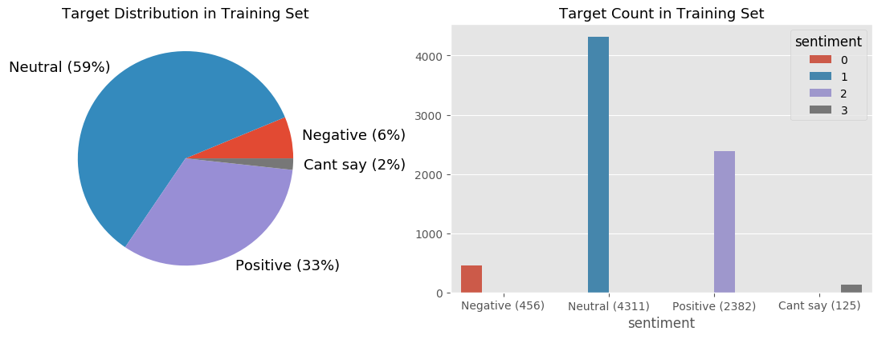
Overall Sentiments of people during the span of this festival

Slide 6
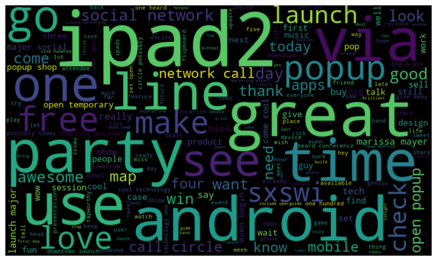
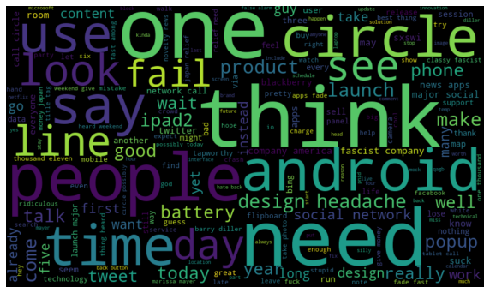
Lets see What people are happy about and sad about
Positive Words
Negative Words

Slide 7
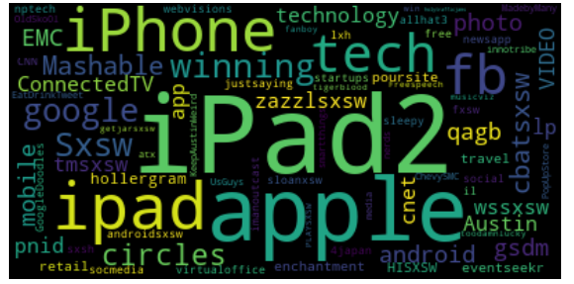
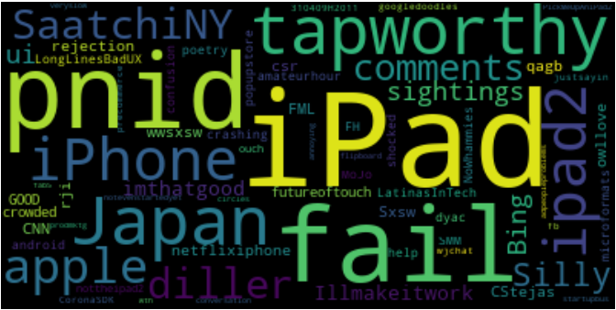
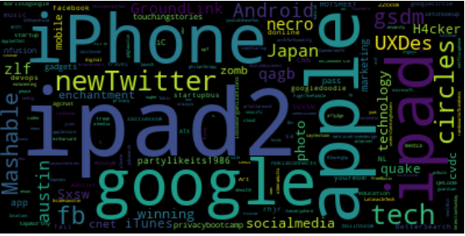
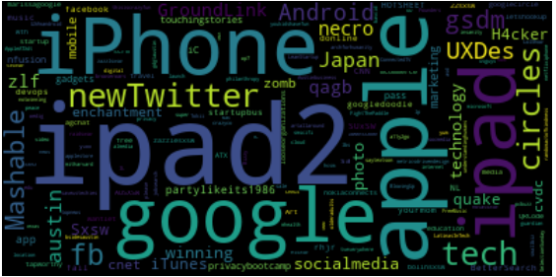
Wordcloud of hashtags
Positive #tags
Negative #tags
Neutral #tags
Can’t say #tags

Slide 8
Why APPLE’s name is everywhere?
Why People are tweeting about it so much ?

Slide 9

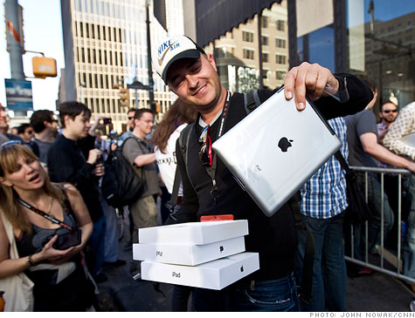
All About Apple
Looking at the popularity of festival Apple has used this opportunity to open a temporary store during festival days to sell their brand new iPad 2

Slide 10

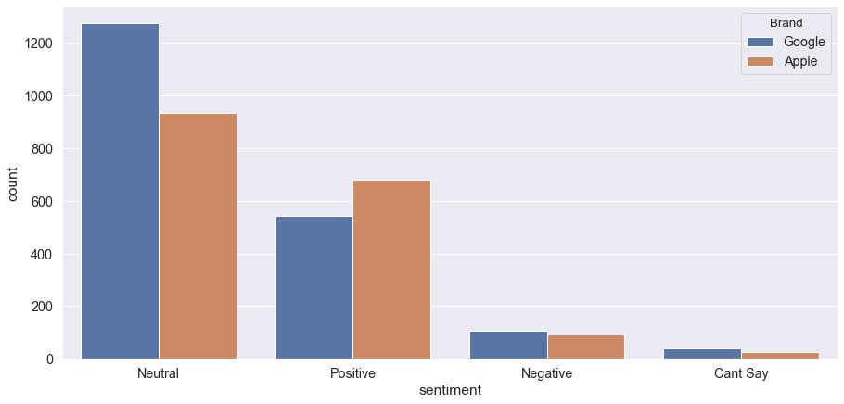
Sentiments towards Apple and Google

Slide 11
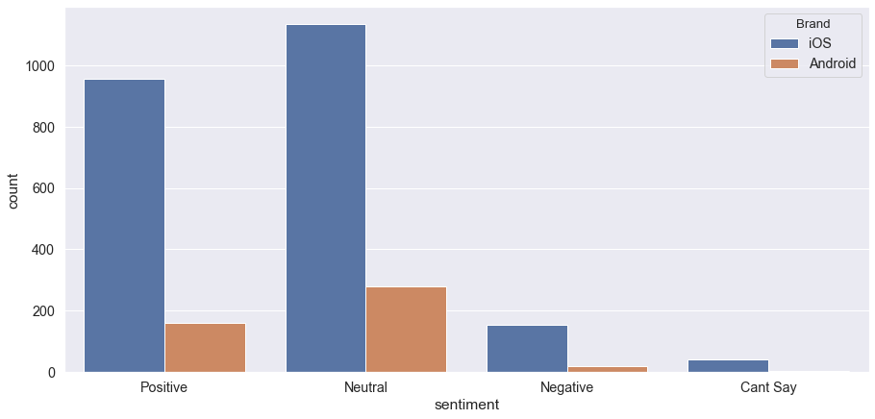
Sentiments towards iOS and Android

Slide 12
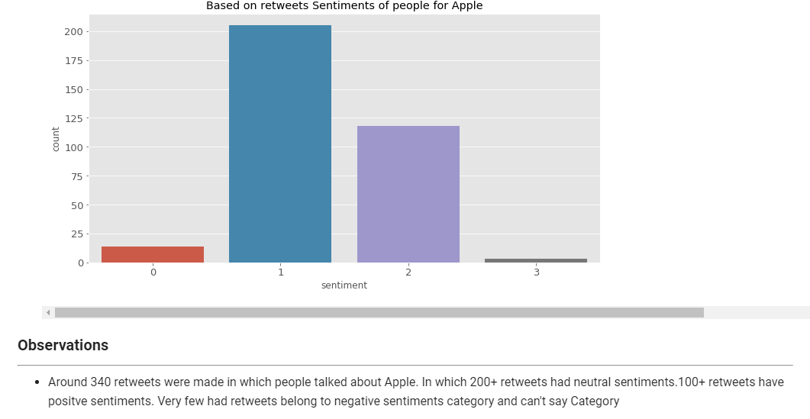
Retweets for apple

Slide 13
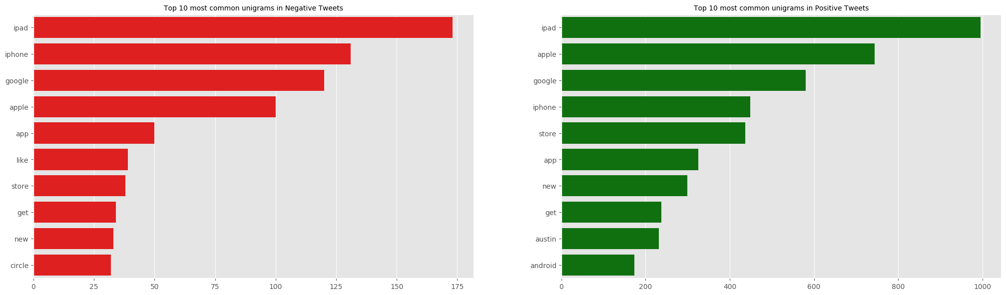
Lets analyze the N-grams in data
Unigram words

Slide 14
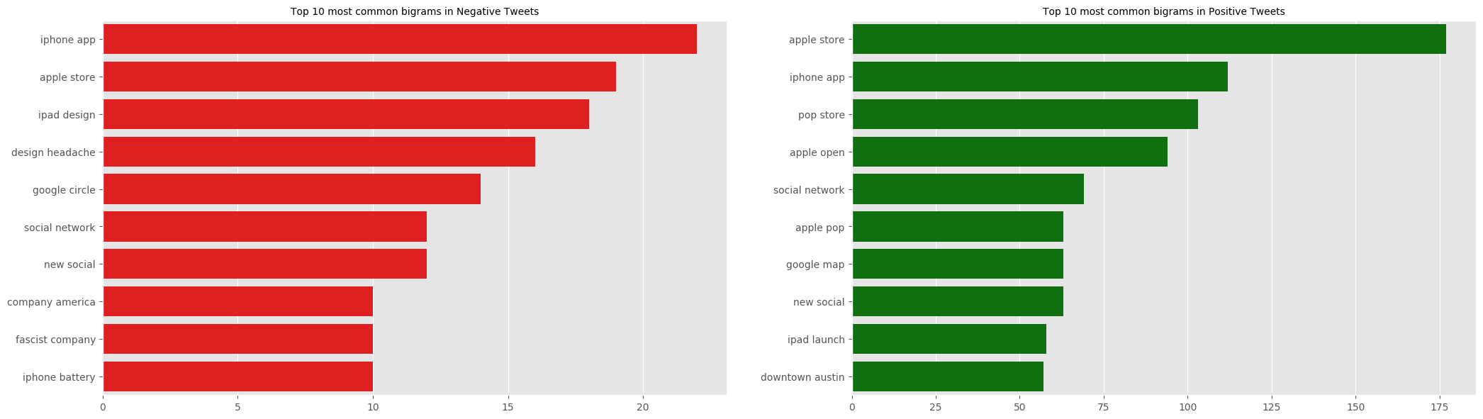
Bigram words

Slide 15
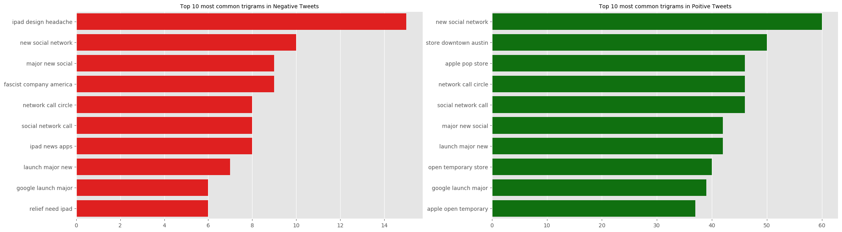
Trigram words

Slide 16
Data Preprocessing Approach
Initial Analysis.
Dropped blank tweet(1).
Combining Train and Test Tweets.
Removed User Handles & Retweets(@mentions , RT).
Removed Urls.
Removed Stopwords , Punctuation and Digits.
Chatwords conversion. (brb – be right back)
Replacing emoticons & emojis with words.
Lemmatization & Stemming with pos tags.

Slide 17
Modelling Approach
Feature Engineering
Vectorization
Count vectorizer
TF-IDF vectorizer
Created Meta Features
Word count
Unique word count
Mean word length
Emojis/emoticons count
Pos Count
Punctuation count
Hashtag count
Character count

Slide 18
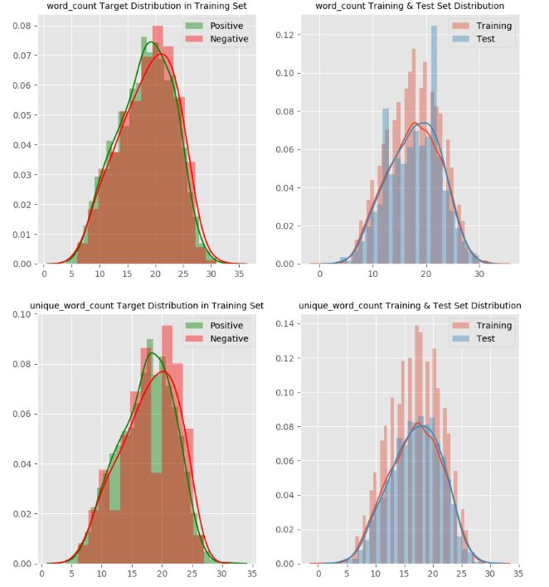
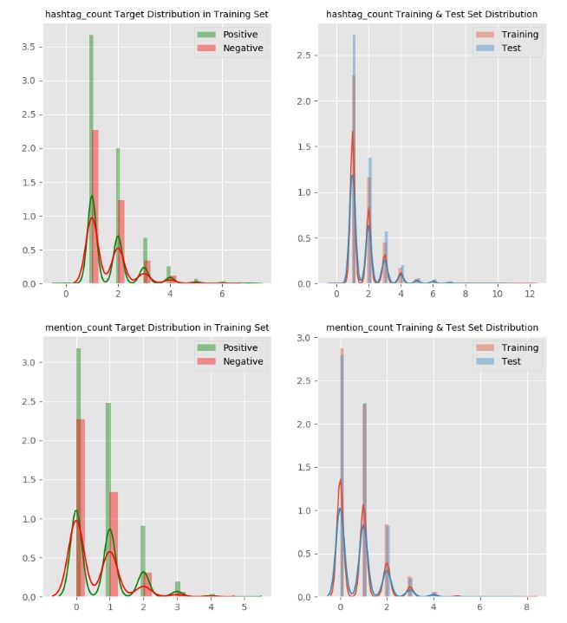

Slide 19
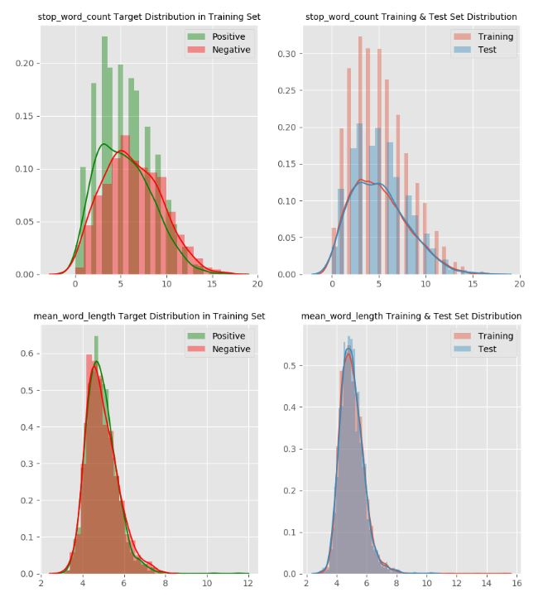

Slide 20
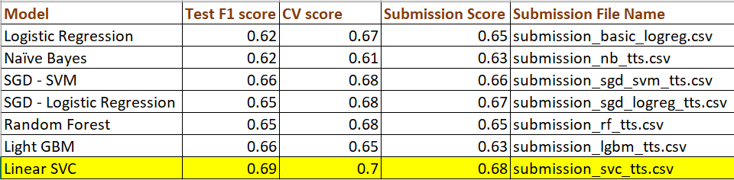
Final Modelling Info

Slide 21
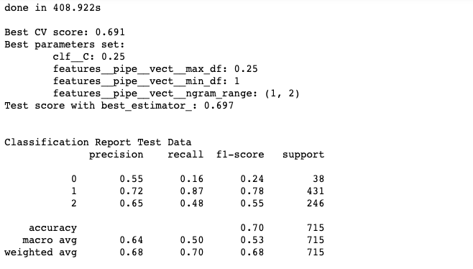
Final model

Slide 22
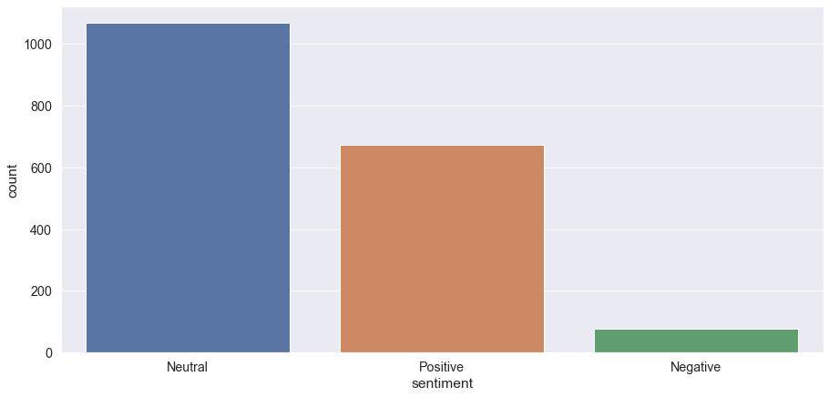
Model Insights

Slide 23
Topic Modelling
LDA
Coherence score to find optimal no of topics
Dominant Topic Analysis
Visualization using word cloud

Slide 24
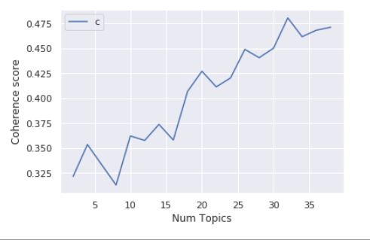
Coherence Plot

Slide 25
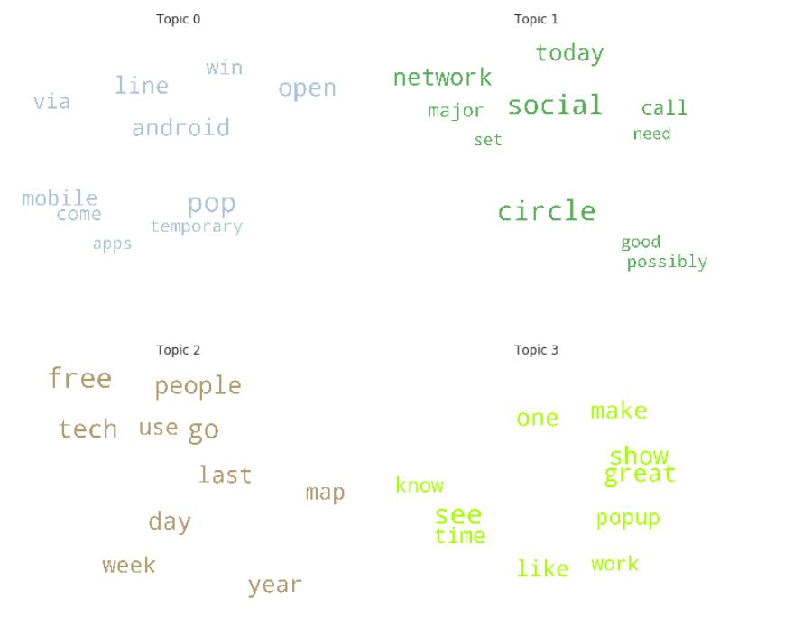

Slide 26
Reference
https://www.machinelearningplus.com/nlp/topic-modeling-gensim-python/#11createthedictionaryandcorpusneededfortopicmodeling

